Slide 1
I-star Model Regression
許中愉, 邢子謙 08/07

Slide 2
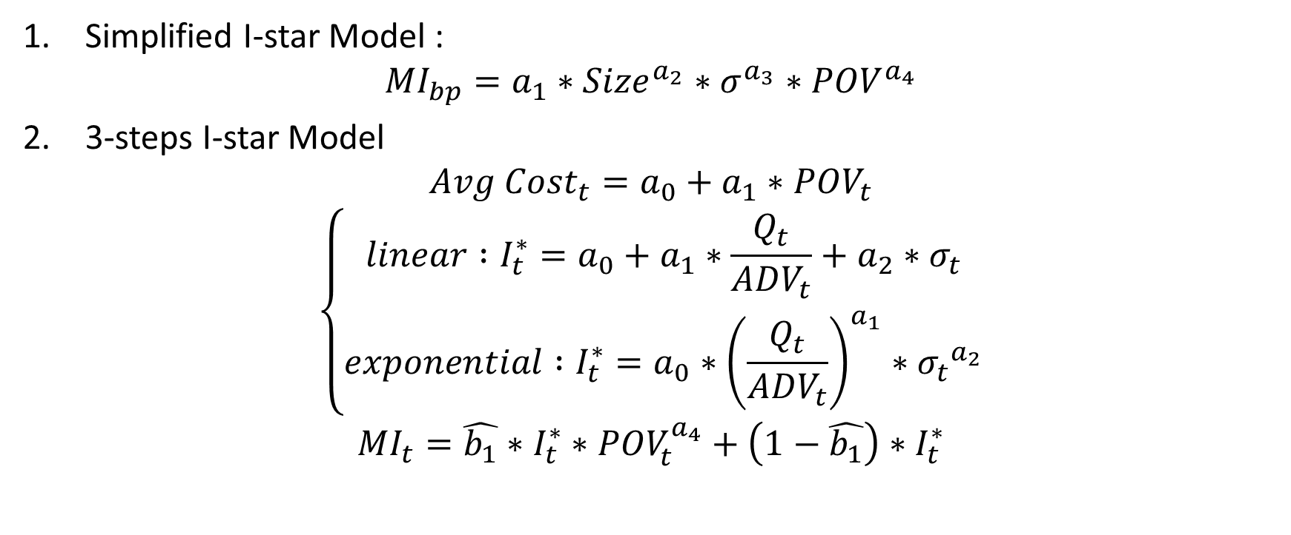
I-star Model Types
Simplified I-star Model : ${MI}_{bp}=a_{1}∗{Size}^{a_{2}}∗σ^{a_{3}}∗{POV}^{a_{4}}$
3-steps I-star Model
$${Avg Cost}_{t}=a_{0}+a_{1}∗{POV}_{t}$$
$$\left\{\begin{aligned}linear :I_{t}^{∗}=a_{0}+a_{1}∗\frac{Q_{t}}{{ADV}_{t}}+a_{2}∗σ_{t} \\ exponential :I_{t}^{∗}=a_{0}∗{\left(\frac{Q_{t}}{{ADV}_{t}}\right)}^{a_{1}}∗{σ_{t}}^{a_{2}}\end{aligned}\right.$$
$${MI}_{t}=\hat{b_{1}}∗I_{t}^{∗}∗{POV}_{t}^{a_{4}}+\left(1−\hat{b_{1}}\right)∗I_{t}^{∗}$$

Slide 3
Result

Slide 4
Simplified I-star Model

Slide 5
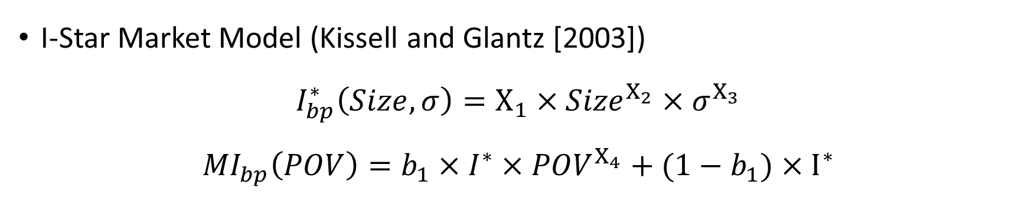
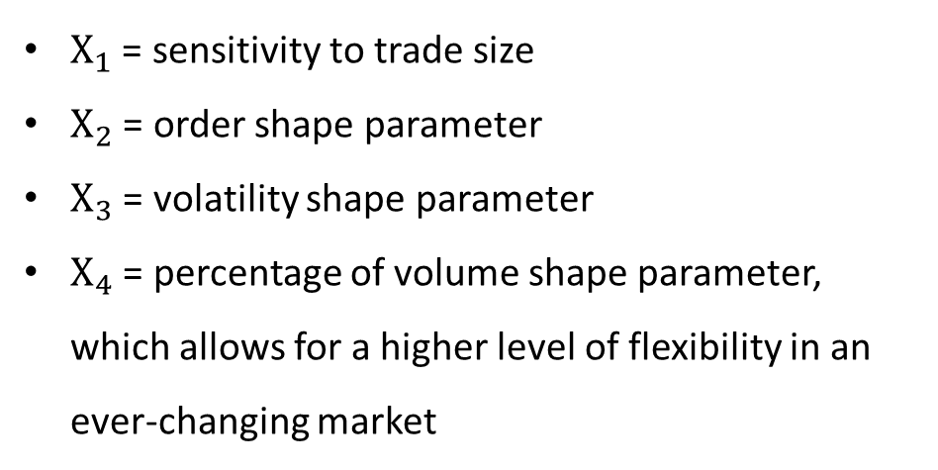
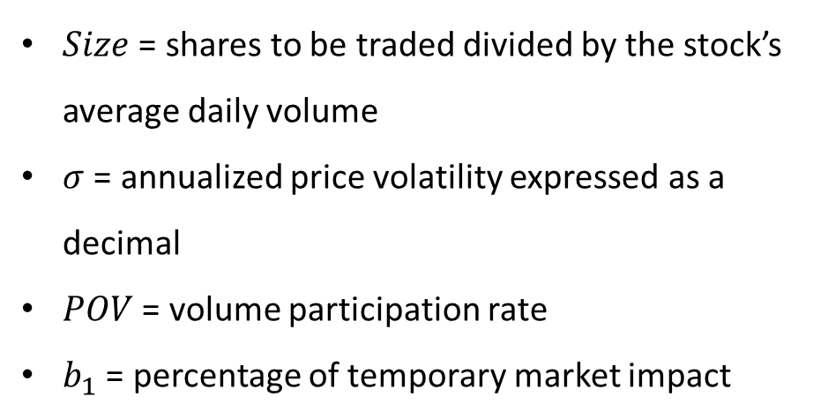
Deciphering Models
I-Star Market Model (Kissell and Glantz [2003])
$$I_{bp}^{∗}\left(Size,σ\right)=X_{1}×{Size}^{X_{2}}×σ^{X_{3}}$$
$${MI}_{bp}\left(POV\right)=b_{1}×I^{∗}×{POV}^{X_{4}}+(1−b_{1})×I^{∗}$$
$Size$ = shares to be traded divided by the stock’s average daily volume
$σ$ = annualized price volatility expressed as a decimal
$POV$ = volume participation rate
$b_{1}$ = percentage of temporary market impact
$X_{1}$ = sensitivity to trade size
$X_{2}$ = order shape parameter
$X_{3}$ = volatility shape parameter
$X_{4}$ = percentage of volume shape parameter, which allows for a higher level of flexibility in an ever-changing market

Slide 6
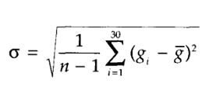
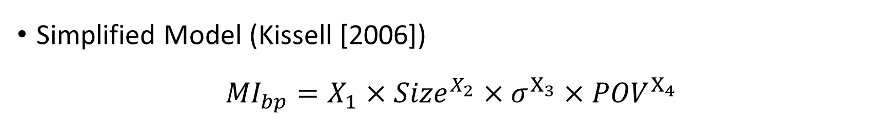
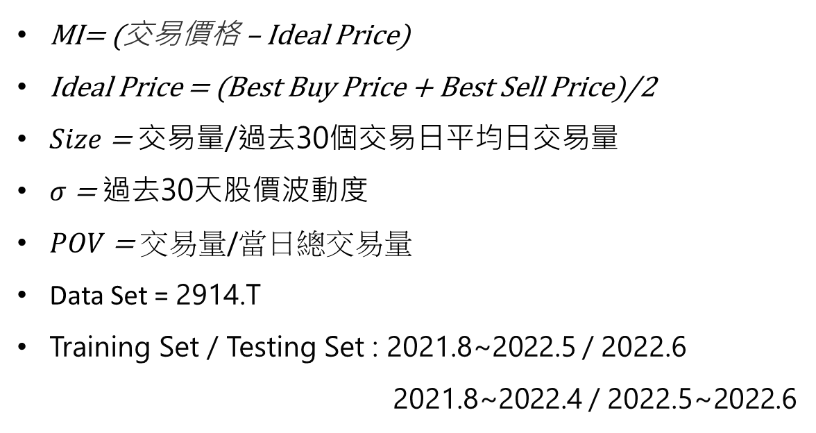
Deciphering Models
Simplified Model (Kissell [2006])
$${MI}_{bp}=X_{1}×{Size}^{X_{2}}×σ^{X_{3}}×{POV}^{X_{4}}$$
MI= (交易價格 – Ideal Price)
Ideal Price = (Best Buy Price + Best Sell Price)/2
$Size$ = 交易量/過去30個交易日平均日交易量
$σ$ = 過去30天股價波動度
$POV$ = 交易量/當日總交易量
Data Set = 2914.T
Training Set / Testing Set : 2021.8~2022.5 / 2022.6
2021.8~2022.4 / 2022.5~2022.6

Slide 7
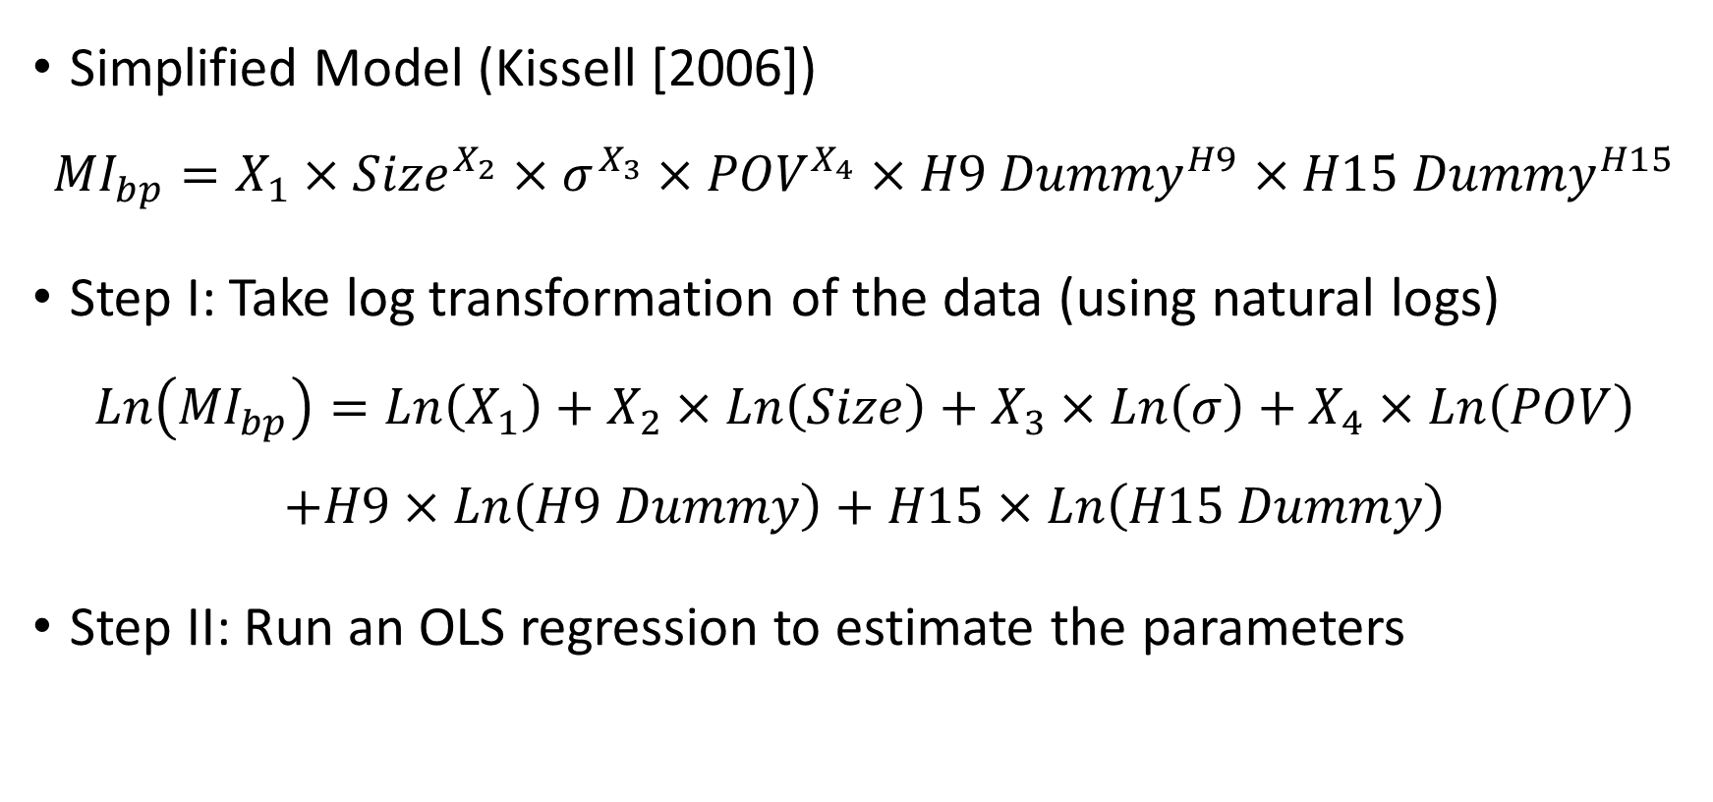
Deciphering Models - Hourly
Simplified Model (Kissell [2006])
$${MI}_{bp}=X_{1}×{Size}^{X_{2}}×σ^{X_{3}}×{POV}^{X_{4}}×{H9 Dummy}^{H9}×{H15 Dummy}^{H15}$$
Step I: Take log transformation of the data (using natural logs)
$$Ln\left({MI}_{bp}\right)=Ln\left(X_{1}\right)+X_{2}×Ln\left(Size\right)+X_{3}×Ln\left(σ\right)+X_{4}×Ln\left(POV\right)$$
$$+H9×Ln\left(H9 Dummy\right)+H15×Ln\left(H15 Dummy\right)$$
Step II: Run an OLS regression to estimate the parameters

Slide 8
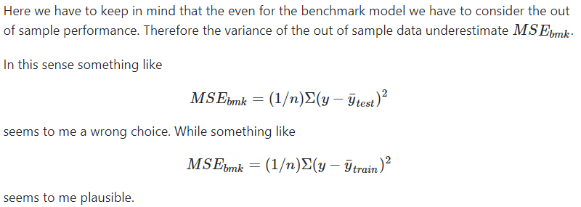
Test Set R-squared 使用 Train Set Mean 計算
將 Train Set 視為 Benchmark
實際交易時無法知道 Test Set 的 Mean

Slide 10
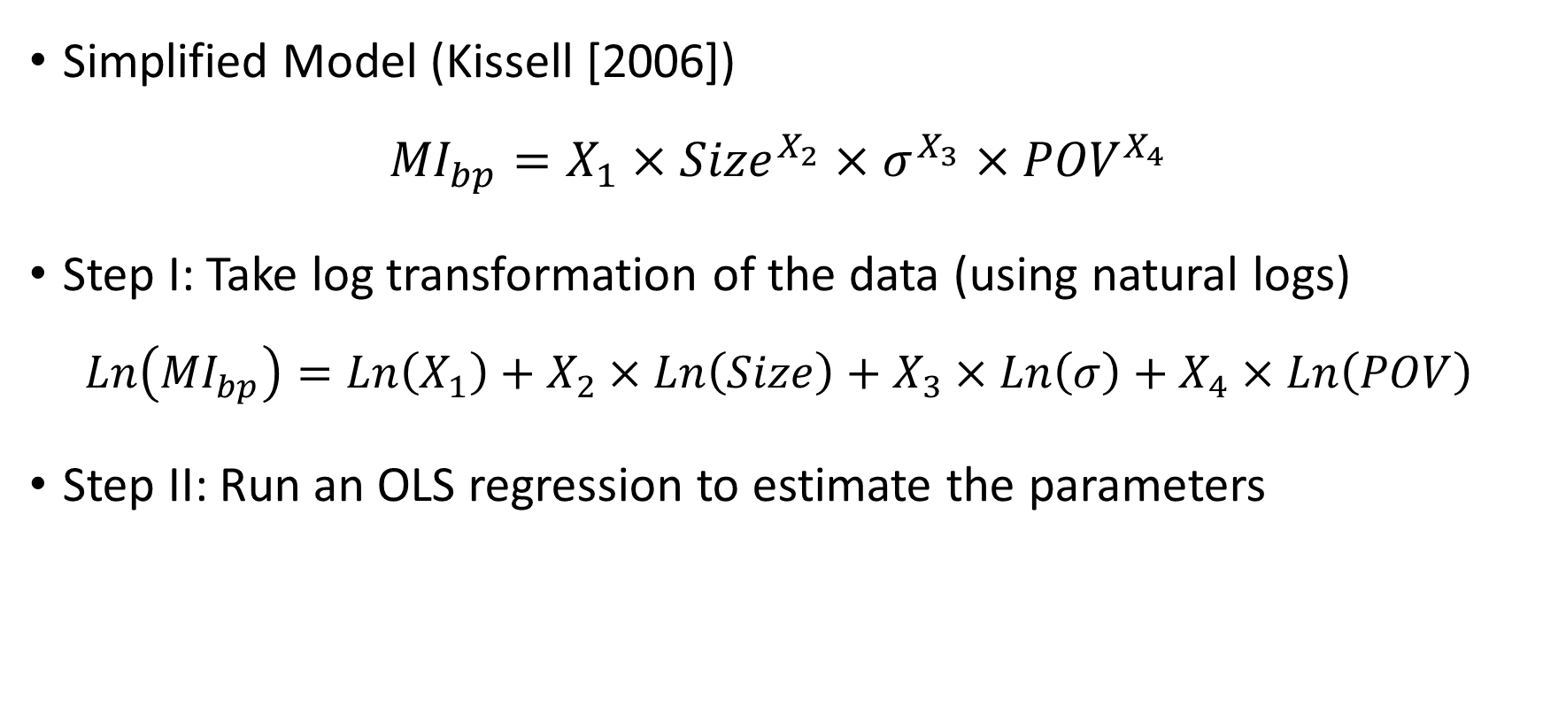
Deciphering Models - Daily
Simplified Model (Kissell [2006])
$${MI}_{bp}=X_{1}×{Size}^{X_{2}}×σ^{X_{3}}×{POV}^{X_{4}}$$
Step I: Take log transformation of the data (using natural logs)
$$Ln\left({MI}_{bp}\right)=Ln\left(X_{1}\right)+X_{2}×Ln\left(Size\right)+X_{3}×Ln\left(σ\right)+X_{4}×Ln\left(POV\right)$$
Step II: Run an OLS regression to estimate the parameters

Slide 12
R-squared < 0 or > train set R-squared
Daily Data - 7 day
Training Set / Testing Set : 2021.8~2022.5 / 2022.6
Assumption: 2022.6 股價特殊變動
R-squared Plot: Train Set – 2021.8~2022.5 / 2021.8~2022.4
Test Set – Train Set 後 1 month / 2 month

Slide 13
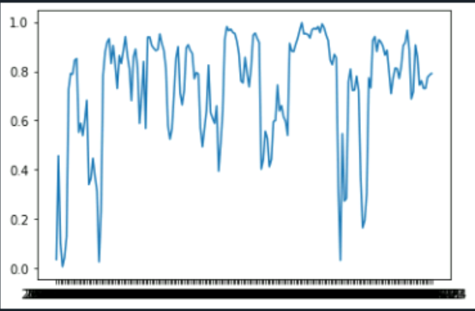
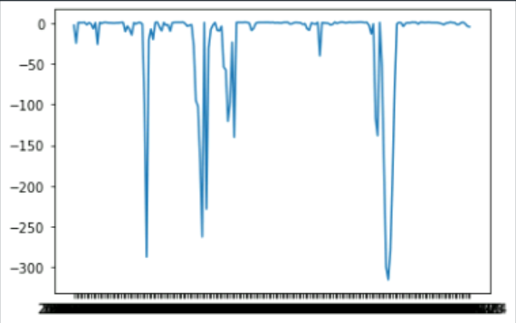
R2-Train 7 day/ Test 30 day
Train
Test

Slide 14
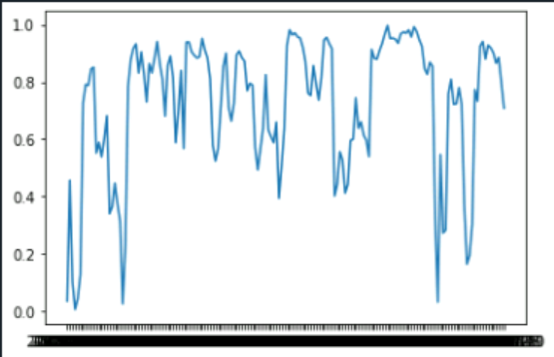
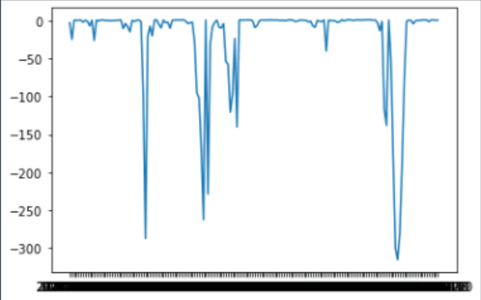
R2-Train 7 day/ Test 60 day
Train
Test

Slide 15
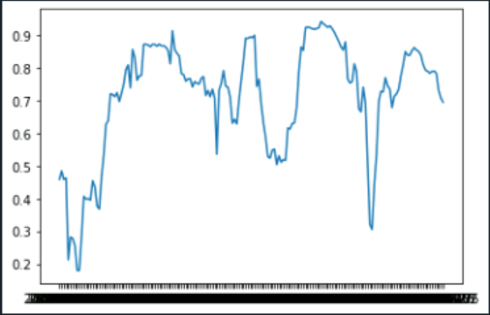
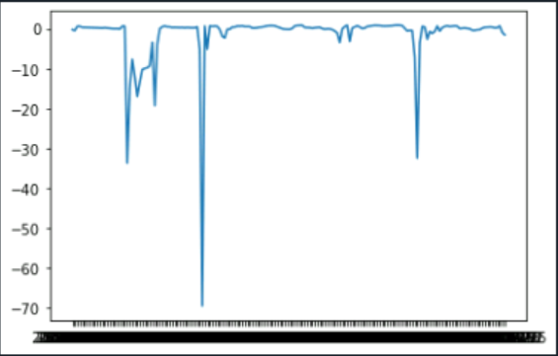
R2-Train 30 day/ Test 30 day
Train
Test

Slide 16
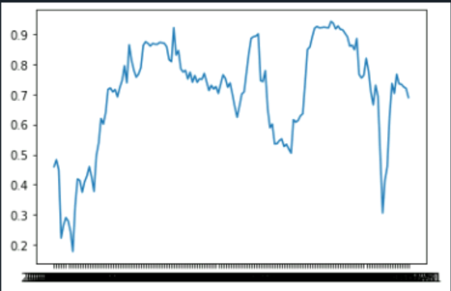
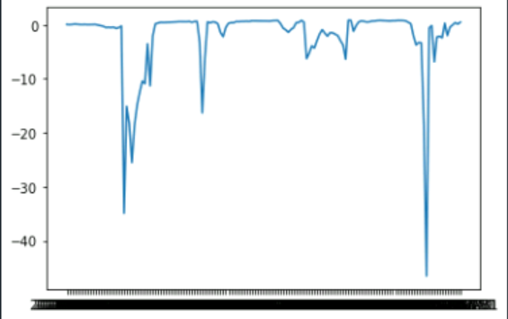
R2-Train 30 day/ Test 60 day
Train
Test

Slide 17
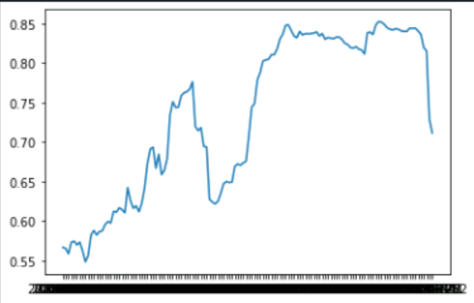
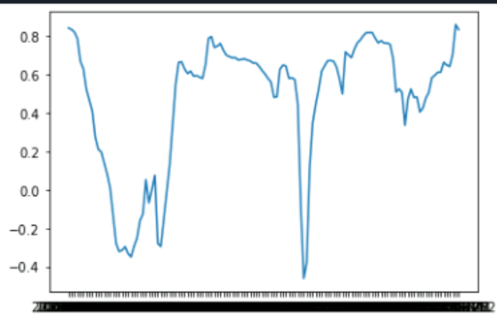
R2-Train 90 day/ Test 30 day
Train
Test

Slide 18
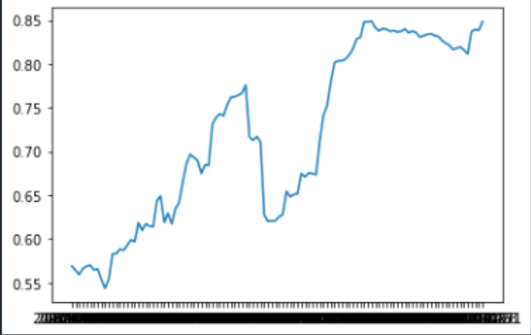
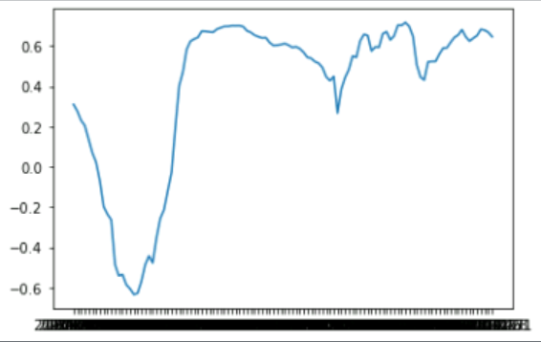
R2-Train 90 day/ Test 60 day
Train
Test

Slide 19
Conclusion
Hourly R-squared > Daily R-squared 是因為 hourly data 可捕捉開收盤時交易量集中的特性
Simplify Model 適用於長期交易，短期不適合
拉長 Train Set 時間可使 Test Set R-squared 提升

Slide 20
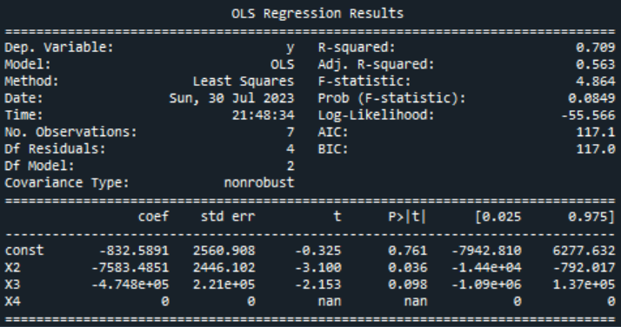
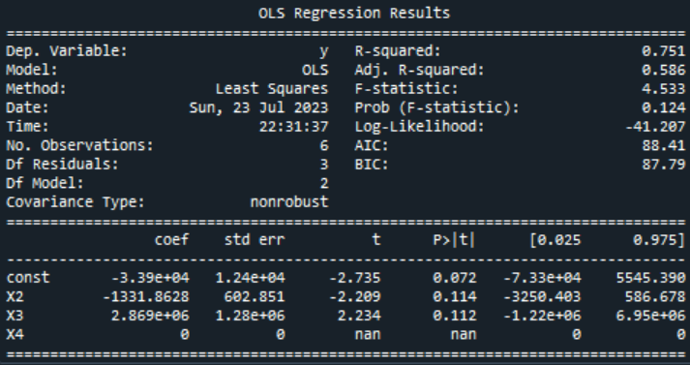
Appendix – Daily 7 day

Slide 21
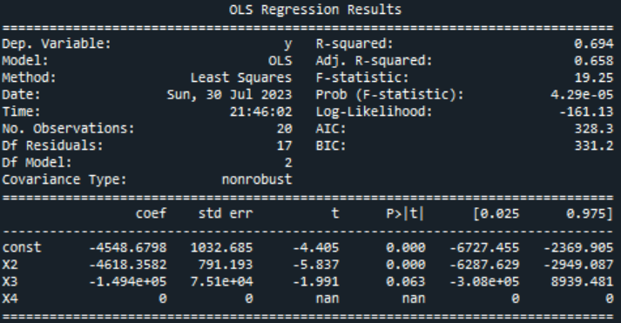
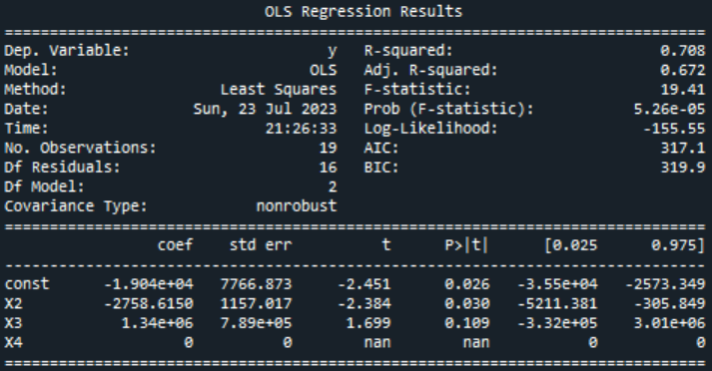
Appendix – Daily 30 day

Slide 22
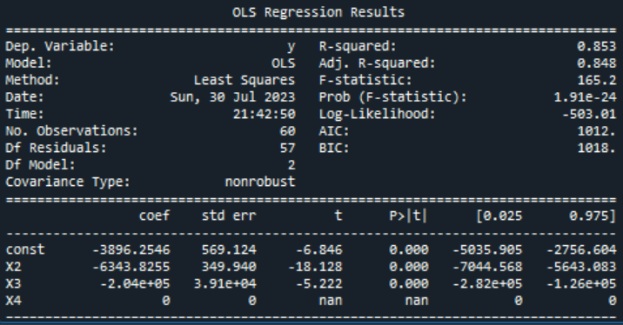
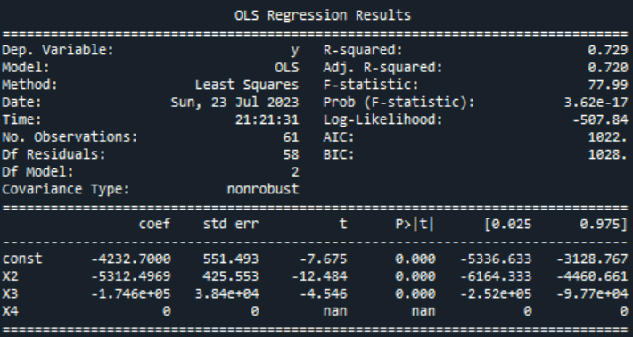
Appendix – Daily 90 day

Slide 23
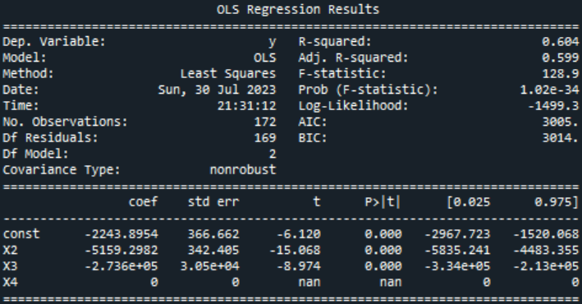
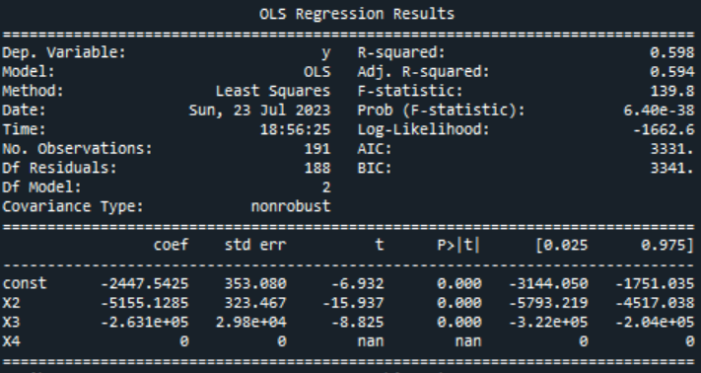
Appendix – Daily 1 year

Slide 24
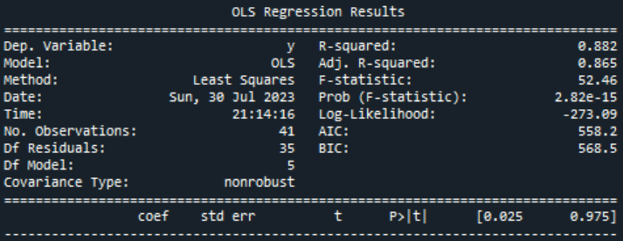
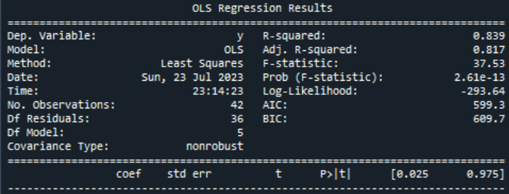
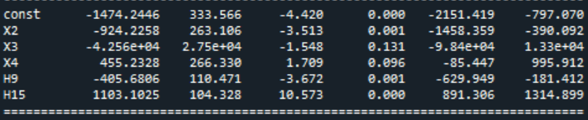
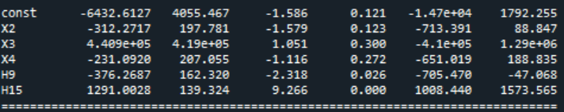
Appendix – Hourly 7 day

Slide 25

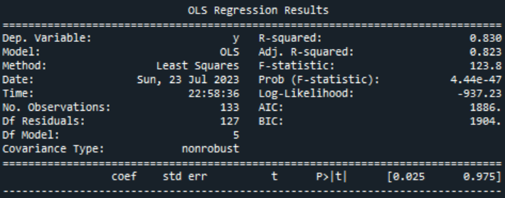
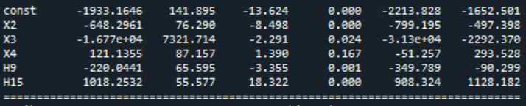
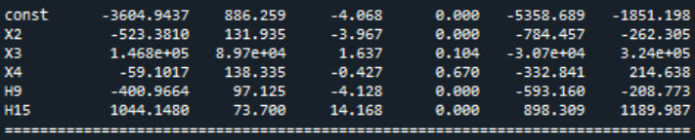
Appendix – Hourly 30 day

Slide 26
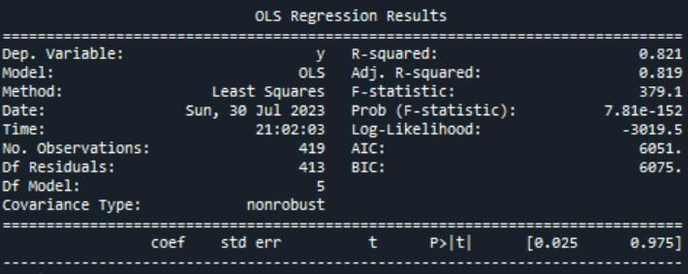

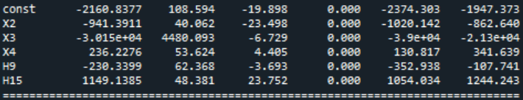
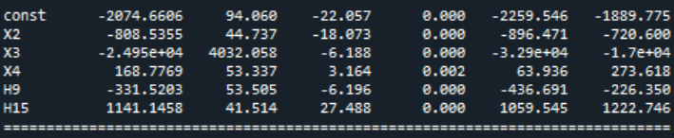
Appendix – Hourly 90 day

Slide 27
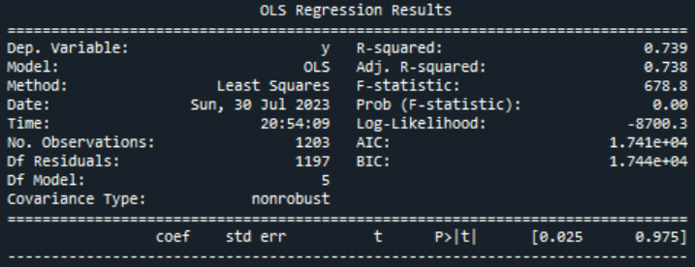
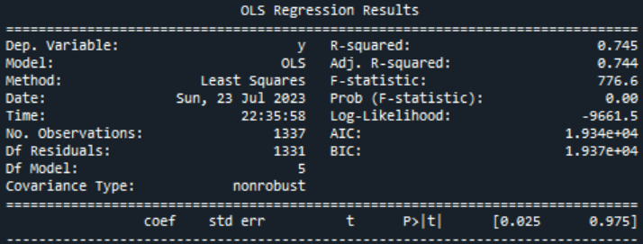
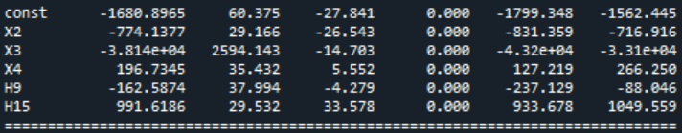
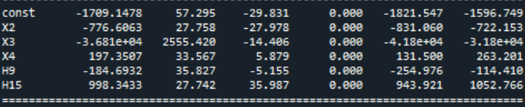
Appendix – Hourly 1 year

Slide 28
3-steps I-star Model

Slide 29
Setting
Stock : 2914.T
Time :
1. Train : 2021.08.04 ~ 2022.04.28, Test : 2022.05.02 ~ 2022.06.30
2. Train : 2022.03.01 ~ 2022.05.31, Test : 2022.06.01 ~ 2022.06.30
Data :
1. Original, 2. Without outlier(V > 2*ADV, delta(P) > 3*sigma)
Heterogeneity :
1. Original, 2. Hetero. adjusted
Model :
1. Linear I-star, 2. Exponential I-star
Sign(Imbalance) :
1. Original, 2. Absolute value

Slide 30
Case
Case 1 : original data / no hetero. adj. / linear I-star / original sign(Q)
Case 2 : without outlier / no hetero. adj. / linear I-star / original sign(Q)
Case 3 : original data / hetero. adj. / linear I-star / original sign(Q)
Case 4 : without outlier / hetero. adj. / linear I-star / original sign(Q)
Case 5 : original data / no hetero. adj. / expo. I-star / original sign(Q)
Case 6 : without outlier / no hetero. adj. / expo. I-star / original sign(Q)
Case 7 : original data / hetero. adj. / linear I-star / absolute sign(Q)
Case 8 : without outlier / hetero. adj. / linear I-star / absolute sign(Q)

Slide 31
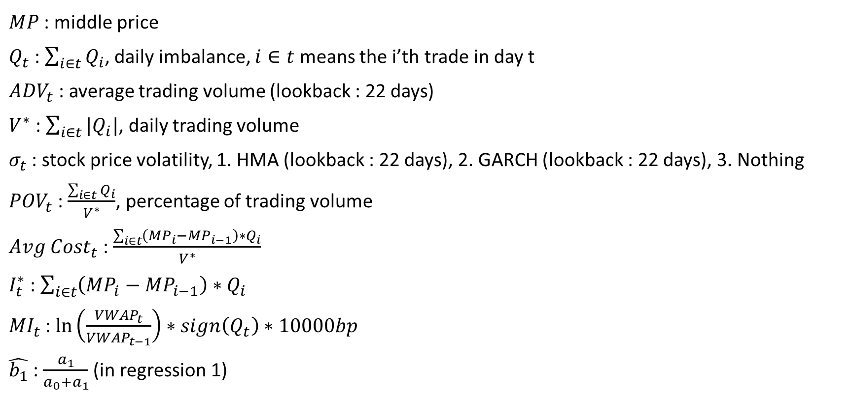
Variable(original)
$MP$ : middle price
$Q_{t}$ : $\sum_{i∈t}{Q_{i}}$, daily imbalance, $i∈t$ means the i’th trade in day t
${ADV}_{t}$ : average trading volume (lookback : 22 days)
$V^{∗}$ : $\sum_{i∈t}{|Q_{i}|}$, daily trading volume
$σ_{t}$ : stock price volatility, 1. HMA (lookback : 22 days), 2. GARCH (lookback : 22 days), 3. Nothing
${POV}_{t}$ : $\frac{\sum_{i∈t}{Q_{i}}}{V^{∗}}$, percentage of trading volume
${Avg Cost}_{t}$ : $\frac{\sum_{i∈t}{\left({MP}_{i}−{MP}_{i−1}\right)∗Q_{i}}}{V^{∗}}$
$I_{t}^{∗}$ : $\sum_{i∈t}{\left({MP}_{i}−{MP}_{i−1}\right)∗Q_{i}}$
${MI}_{t}$ : $\ln\left(\frac{{VWAP}_{t}}{{VWAP}_{t−1}}\right)∗sign\left(Q_{t}\right)∗10000bp$
$\hat{b_{1}}$ : $\frac{a_{1}}{a_{0}+a_{1}}$ (in regression 1)

Slide 32
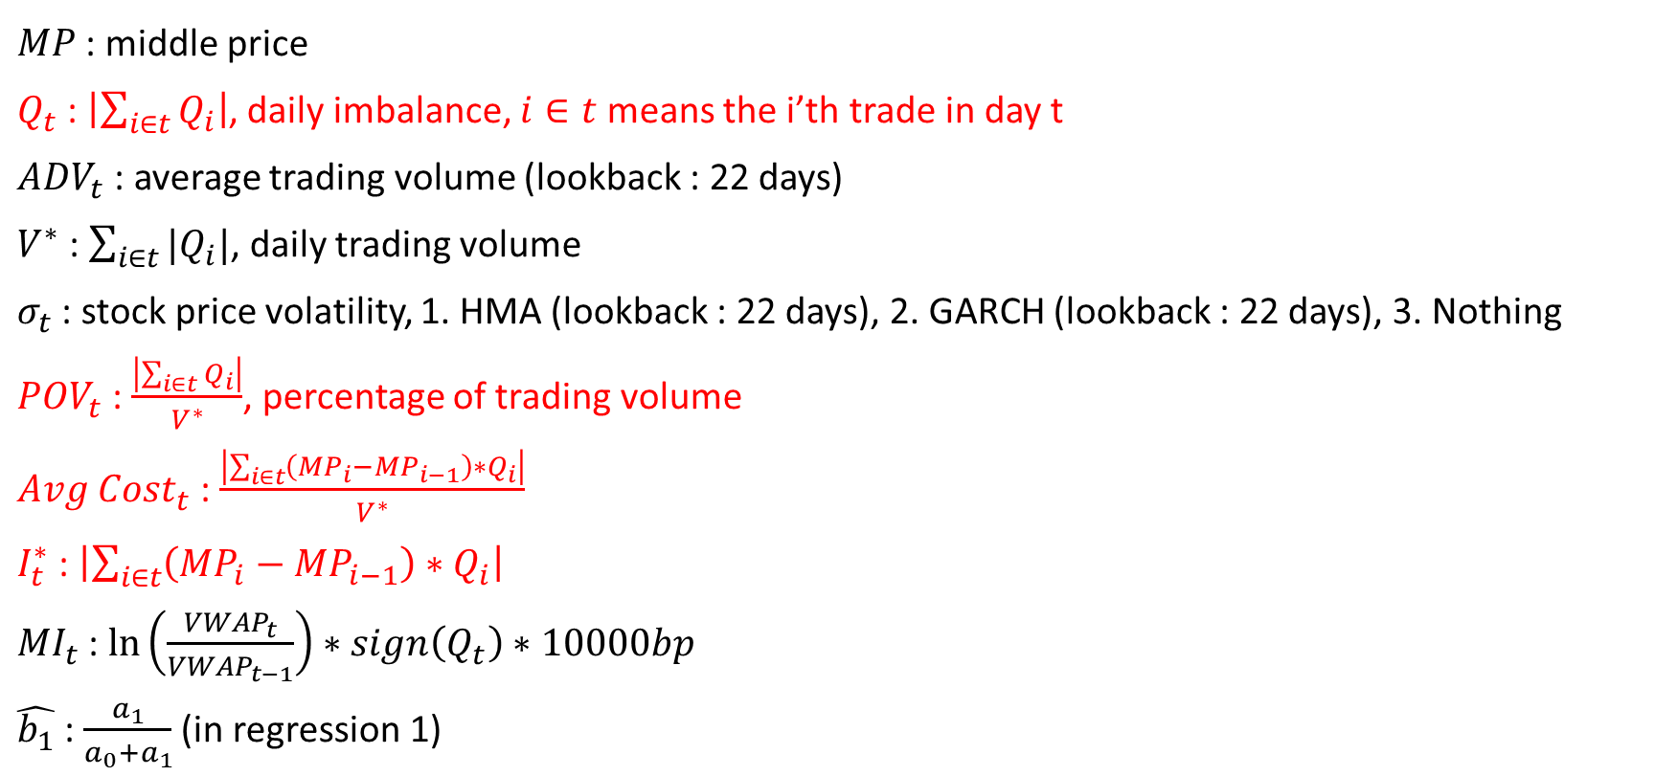
Variable(absolute sign(Q))
$MP$ : middle price
$Q_{t}$ : $\left|\sum_{i∈t}{Q_{i}}\right|$, daily imbalance, $i∈t$ means the i’th trade in day t
${ADV}_{t}$ : average trading volume (lookback : 22 days)
$V^{∗}$ : $\sum_{i∈t}{|Q_{i}|}$, daily trading volume
$σ_{t}$ : stock price volatility, 1. HMA (lookback : 22 days), 2. GARCH (lookback : 22 days), 3. Nothing
${POV}_{t}$ : $\frac{\left|\sum_{i∈t}{Q_{i}}\right|}{V^{∗}}$, percentage of trading volume
${Avg Cost}_{t}$ : $\frac{\left|\sum_{i∈t}{\left({MP}_{i}−{MP}_{i−1}\right)∗Q_{i}}\right|}{V^{∗}}$
$I_{t}^{∗}$ : $\left|\sum_{i∈t}{\left({MP}_{i}−{MP}_{i−1}\right)∗Q_{i}}\right|$
${MI}_{t}$ : $\ln\left(\frac{{VWAP}_{t}}{{VWAP}_{t−1}}\right)∗sign\left(Q_{t}\right)∗10000bp$
$\hat{b_{1}}$ : $\frac{a_{1}}{a_{0}+a_{1}}$ (in regression 1)

Slide 33

Regression 1
Original regression :
$${Avg Cost}_{t}=a_{0}+a_{1}∗{POV}_{t}$$
Heterogeneity adjusted :
$$\frac{{Avg Cost}_{t}}{\sqrt{|{POV}_{t}|}}=\frac{a_{0}}{\sqrt{|{POV}_{t}|}}+a_{1}∗\frac{{POV}_{t}}{\sqrt{|{POV}_{t}|}}$$

Slide 34
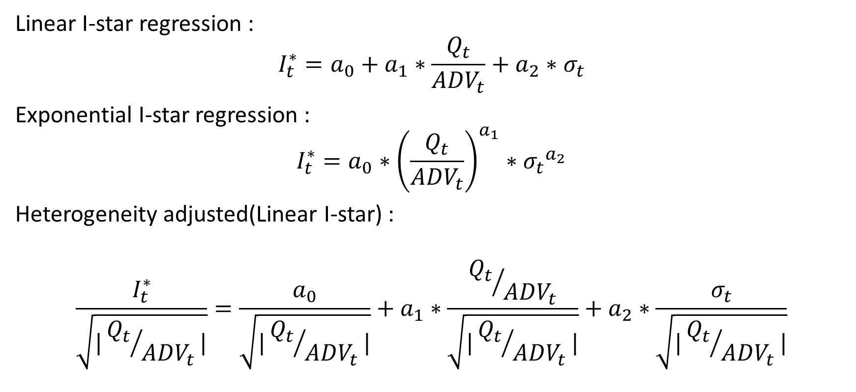
Regression 2
Linear I-star regression :
$$I_{t}^{∗}=a_{0}+a_{1}∗\frac{Q_{t}}{{ADV}_{t}}+a_{2}∗σ_{t}$$
Exponential I-star regression :
$$I_{t}^{∗}=a_{0}∗{\left(\frac{Q_{t}}{{ADV}_{t}}\right)}^{a_{1}}∗{σ_{t}}^{a_{2}}$$
Heterogeneity adjusted(Linear I-star) :
$$\frac{I_{t}^{∗}}{\sqrt{|{Q_{t}}/{{ADV}_{t}}|}}=\frac{a_{0}}{\sqrt{|{Q_{t}}/{{ADV}_{t}}|}}+a_{1}∗\frac{{Q_{t}}/{{ADV}_{t}}}{\sqrt{|{Q_{t}}/{{ADV}_{t}}|}}+a_{2}∗\frac{σ_{t}}{\sqrt{|{Q_{t}}/{{ADV}_{t}}|}}$$

Slide 35
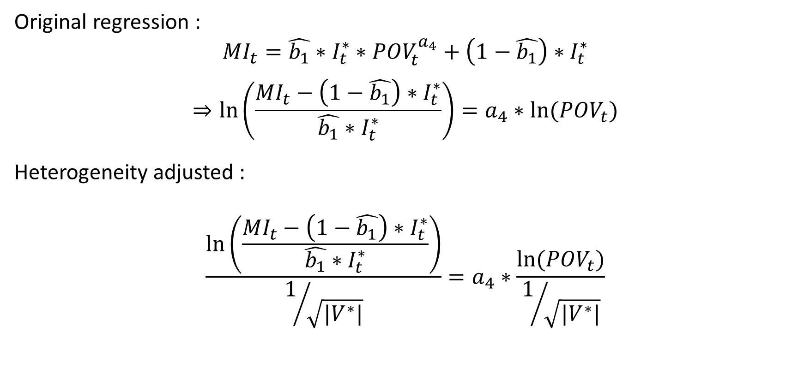
Regression 3
Original regression :
$${MI}_{t}=\hat{b_{1}}∗I_{t}^{∗}∗{POV}_{t}^{a_{4}}+\left(1−\hat{b_{1}}\right)∗I_{t}^{∗}$$
$$⇒\ln\left(\frac{{MI}_{t}−\left(1−\hat{b_{1}}\right)∗I_{t}^{∗}}{\hat{b_{1}}∗I_{t}^{∗}}\right)=a_{4}∗ln⁡({POV}_{t})$$
Heterogeneity adjusted :
$$\frac{\ln\left(\frac{{MI}_{t}−\left(1−\hat{b_{1}}\right)∗I_{t}^{∗}}{\hat{b_{1}}∗I_{t}^{∗}}\right)}{1/{\sqrt{|V^{∗}|}}}=a_{4}∗\frac{ln⁡({POV}_{t})}{1/{\sqrt{|V^{∗}|}}}$$

Slide 36
Result 1
 | Training set 21.08.04 ~ 22.04.28 |  |  | Testing set 22.05.02 ~ 22.06.30
 | MAPE | NRMSE | R-squared | MAPE | NRMSE | R-squared
Case 1 | 0.3968 | 0.8262 | 0.778 | 0.3315 | 1.0353 | -1653.510
Case 2 | 0.4082 | 0.8210 | 0.772 | 0.3279 | 1.0391 | -388.882
Case 3 | 0.4044 | 0.7312 | 0.778 | 0.3382 | 1.0107 | -2.603
Case 4 | 0.4123 | 0.7471 | 0.766 | 0.3662 | 0.9782 | -2.607
Case 5 | 0.3270 | 0.6462 | 0.839 | 0.2863 | 0.8549 | -20473.792
Case 6 | 0.3339 | 0.6222 | 0.832 | 0.2868 | 0.8613 | -6962.898
Case 7 | 0.4044 | 0.7277 | 0.778 | 0.3421 | 1.0138 | -2.673
Case 8 | 0.4119 | 0.7625 | 0.767 | 0.3484 | 1.0192 | -2.307

Slide 37
Result 2
 | Training set 22.03.01 ~ 22.05.31 |  |  | Testing set 22.06.01 ~ 22.06.30
 | MAPE | NRMSE | R-squared | MAPE | NRMSE | R-squared
Case 1 | 0.3759 | 0.8291 | 0.800 | 0.3989 | 1.1601 | -164065.092
Case 2 | 0.3967 | 0.8935 | 0.790 | 0.4078 | 1.1726 | -14567.448
Case 3 | 0.3843 | 0.7693 | 0.790 | 0.4253 | 1.2217 | -5.400
Case 4 | 0.3916 | 0.7959 | 0.772 | 0.4248 | 1.2209 | -5.340
Case 5 | 0.3197 | 0.6343 | 0.826 | 0.3458 | 1.1029 | -22250.540
Case 6 | 0.3458 | 0.6251 | 0.805 | 0.3551 | 1.1144 | -2987.762
Case 7 | 0.3847 | 0.7740 | 0.779 | 0.4251 | 1.2206 | -5.381
Case 8 | 0.3959 | 0.8093 | 0.769 | 0.4279 | 1.2249 | -5.371

Slide 38
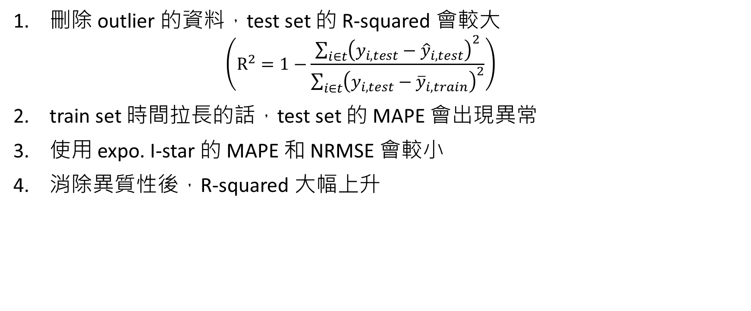
Conclusion from data
刪除 outlier 的資料，test set 的 R-squared 會較大 $\left(R^{2}=1−\frac{\sum_{i∈t}{{\left(y_{i,test}−{\hat{y}}_{i,test}\right)}^{2}}}{\sum_{i∈t}{{\left(y_{i,test}−{\overline{y}}_{i,train}\right)}^{2}}}\right)$
train set 時間拉長的話，test set 的 MAPE 會出現異常
使用 expo. I-star 的 MAPE 和 NRMSE 會較小
消除異質性後，R-squared 大幅上升

Slide 39
Problem
I-star 希望透過過去的交易資料來預測股價，若使用固定的 data 應該不具有預測效果，未來可嘗試使用“Rolling”的方式處理。
I-star 變數定義較為困難，現有定義與 MI 的數量級相差過大，因此在處理第三條回歸式時會產生 log 內皆為負號的問題。
資料上不允許 MI 和 I-star 使用共同的基準，MI 需要有逐筆資料的 VWAP 才可以使用 tick data，而 I-star 則會有高、低估的問題存在。

Slide 40
I-star 高、低估問題
假設現在有三筆數量為 V 的交易，造成 10V 的瞬時影響，並個別會遞延 1V 的永久影響。
若使用 tick data，我們可以記錄下來 : 三筆 V 造成 10V 的結果 → 但因為 MI 無法使用 tick data，因此無法使用
若使用 interval data，則為 : 一筆 3V 造成 12V 的結果 → 但因為 data 放入回歸前已經過前處理，因此會產生誤差

Slide 41
Appendix 1
Case 1 : original data / no hetero. adj. / linear I-star / original sign(Q)
 | Training set 21.08.04 ~ 22.04.28 | Testing set 22.05.02 ~ 22.06.30 | Training set 22.03.01 ~ 22.05.31 | Testing set 21.06.01 ~ 22.06.30
Sigma choose | GARCH (r2 = 0.431) | GARCH | HMA (r2 = -0.608) | HMA
MAE | 1.6461 | 1.3714 | 1.7125 | 1.8220
MAPE | 0.3968 | 0.3315 | 0.3759 | 0.3989
MSE | 3.8187 | 2.5789 | 4.1610 | 4.1149
RMSE | 1.9542 | 1.6059 | 2.0399 | 2.0285
NRMSE | 0.8262 | 1.0353 | 0.8291 | 1.1601
R-squared | 0.778 | -1653.5098 | 0.800 | -164065.0918

Slide 42
Appendix 2
Case 2 : without outlier / no hetero. adj. / linear I-star / original sign(Q)
 | Training set 21.08.04 ~ 22.04.28 | Testing set 22.05.02 ~ 22.06.30 | Training set 22.03.01 ~ 22.05.31 | Testing set 21.06.01 ~ 22.06.30
Sigma choose | HMA (r2 = 0.326) | HMA | HMA (r2 = -0.473) | HMA
MAE | 1.9475 | 1.5929 | 2.0876 | 2.1771
MAPE | 0.4082 | 0.3279 | 0.3967 | 0.4078
MSE | 5.3615 | 3.4482 | 5.9701 | 5.7933
RMSE | 2.3155 | 1.8569 | 2.4434 | 2.4069
NRMSE | 0.8210 | 1.0391 | 0.8935 | 1.1726
R-squared | 0.772 | -388.8815 | 0.790 | -14567.4476

Slide 43
Appendix 3
Case 3 : original data / hetero. adj. / linear I-star / original sign(Q)
 | Training set 21.08.04 ~ 22.04.28 | Testing set 22.05.02 ~ 22.06.30 | Training set 22.03.01 ~ 22.05.31 | Testing set 21.06.01 ~ 22.06.30
Sigma choose | GARCH (r2 = 0.312) | GARCH | Nothing (r2 = 0.213) | Nothing
MAE | 3511.2785 | 3401.4168 | 3754.1222 | 4010.6023
MAPE | 0.4044 | 0.3382 | 0.3843 | 0.4253
MSE | 17902777.1254 | 15653193.9889 | 20742565.6199 | 19000255.7706
RMSE | 4231.1673 | 3956.4118 | 4554.4007 | 4358.9283
NRMSE | 0.7312 | 1.0107 | 0.7693 | 1.2217
R-squared | 0.778 | -2.6026 | 0.790 | -5.4004

Slide 44
Appendix 4
Case 4 : without outlier / hetero. adj. / linear I-star / original sign(Q)
 | Training set 21.08.04 ~ 22.04.28 | Testing set 22.05.02 ~ 22.06.30 | Training set 22.03.01 ~ 22.05.31 | Testing set 21.06.01 ~ 22.06.30
Sigma choose | Nothing (r2 = 0.287) | Nothing | Nothing (r2 = 0.256) | Nothing
MAE | 3553.4449 | 3633.3778 | 3811.2042 | 4055.502
MAPE | 0.4123 | 0.3662 | 0.3916 | 0.4248
MSE | 18151870.1385 | 18022061.6840 | 21071157.5759 | 19440629.4168
RMSE | 4260.5012 | 4245.2399 | 4590.3331 | 4409.1529
NRMSE | 0.7471 | 0.9782 | 0.7959 | 1.2209
R-squared | 0.766 | -2.6069 | 0.772 | -5.3396

Slide 45
Appendix 5
Case 5 : original data / no hetero. adj. / expo. I-star / original sign(Q)
 | Training set 21.08.04 ~ 22.04.28 | Testing set 22.05.02 ~ 22.06.30 | Training set 22.03.01 ~ 22.05.31 | Testing set 21.06.01 ~ 22.06.30
Sigma choose | GARCH (r2 = 0.436) | GARCH | HMA (r2 = 0.350) | HMA
MAE | 1.3523 | 1.1877 | 1.4438 | 1.5809
MAPE | 0.3270 | 0.2863 | 0.3197 | 0.3458
MSE | 2.7671 | 2.1795 | 3.6135 | 3.3043
RMSE | 1.6635 | 1.4763 | 1.9009 | 1.8178
NRMSE | 0.6462 | 0.8549 | 0.6343 | 1.1029
R-squared | 0.839 | -20473.7922 | 0.826 | -22250.5395

Slide 46
Appendix 6
Case 6 : without outlier / no hetero. adj. / expo. I-star / original sign(Q)
 | Training set 21.08.04 ~ 22.04.28 | Testing set 22.05.02 ~ 22.06.30 | Training set 22.03.01 ~ 22.05.31 | Testing set 21.06.01 ~ 22.06.30
Sigma choose | HMA (r2 = 0.392) | HMA | HMA (r2 = 0.325) | HMA
MAE | 1.5974 | 1.3882 | 1.7798 | 1.8980
MAPE | 0.3339 | 0.2868 | 0.3458 | 0.3551
MSE | 3.9337 | 2.9766 | 5.4987 | 4.6951
RMSE | 1.9833 | 1.7253 | 2.3449 | 2.1668
NRMSE | 0.6222 | 0.8613 | 0.6251 | 1.1144
R-squared | 0.832 | -6962.8976 | 0.805 | -2987.7621

Slide 47
Appendix 7
Case 7 : original data / hetero. adj. / linear I-star / absolute sign(Q)
 | Training set 21.08.04 ~ 22.04.28 | Testing set 22.05.02 ~ 22.06.30 | Training set 22.03.01 ~ 22.05.31 | Testing set 21.06.01 ~ 22.06.30
Sigma choose | GARCH (r2 = 0.416) | GARCH | HMA (r2 = -2.507) | HMA
MAE | 2365.4940 | 2309.4001 | 3740.9588 | 3990.8583
MAPE | 0.4044 | 0.3421 | 0.3847 | 0.4251
MSE | 8141785.5548 | 7232817.3405 | 20500660.4096 | 18828642.1601
RMSE | 2853.3814 | 2689.3898 | 4527.7655 | 4339.1983
NRMSE | 0.7277 | 1.0138 | 0.7740 | 1.2206
R-squared | 0.778 | -2.6734 | 0.779 | -5.3809

Slide 48
Appendix 8
Case 8 : without outlier / hetero. adj. / linear I-star / absolute sign(Q)
 | Training set 21.08.04 ~ 22.04.28 | Testing set 22.05.02 ~ 22.06.30 | Training set 22.03.01 ~ 22.05.31 | Testing set 21.06.01 ~ 22.06.30
Sigma choose | HMA (r2 = 0.057) | HMA | HMA (r2 = -0.302) | HMA
MAE | 2263.2835 | 2257.5655 | 3774.6896 | 4008.0836
MAPE | 0.4119 | 0.3484 | 0.3959 | 0.4279
MSE | 7311655.6048 | 6813943.9295 | 20351305.1760 | 18928816.7888
RMSE | 2704.0073 | 2610.3532 | 4511.2421 | 4350.7260
NRMSE | 0.7625 | 1.0192 | 0.8093 | 1.2249
R-squared | 0.767 | -2.3077 | 0.769 | -5.3714

